Slide 1

Geometry
Unit 5, Lesson 7 Corresponding Parts of Congruent Triangles Are Congruent Volume 1, pg. 262

Slide 2


Benchmarks
MA.912.GR.1.2 Prove triangle congruence or similarity using Side-Side-Side, Side-Angle-Side, Angle-Side-Angle, Angle-Angle-Side, Angle-Angle, and Hypotenuse-Leg.
MA.912.GR.1.6 Solve mathematical and real-world problems involving congruence or similarity in two-dimensional figures.
MA.912.LT.4.10 Judge the validity of arguments and give counterexamples to disprove statements.
volume 1, pg. 262

Slide 3
Integrated Mathematical Thinking and Reasoning Standards
MA.K12.MTR.1.1 Actively participate in effortful learning both individually and collectively.
MA.K12.MTR.4.1 Engage in discussions that reflect on the mathematical thinking of self and others.
MA.K12.MTR.5.1 Use patterns and structure to help understand and connect mathematical concepts.
volume 1, pg. 262

Slide 4

Learning Targets
I understand how to use corresponding parts of congruent triangles in a proof.
I can prove parts of triangles are congruent using triangle congruence and corresponding parts of congruent triangles.
volume 1, pg. 262

Slide 5

Warm-Up
volume 1, pg. 262

Slide 6
5.7.1 Warm-Up: Brain Teaser
Brain teasers like this have been traced back to medieval times. Here’s one with a Florida twist.
A man has to take a panther, a raccoon, and some strawberries across St. John’s river. His rowboat has enough room for the man, plus either the panther or the raccoon or the strawberries. If he takes the strawberries with him, the panther will eat the raccoon. If he takes the panther, the raccoon will eat the strawberries. Only when the man is present are the raccoon and the strawberries safe from their enemies. All the same, the man successfully carries panther, raccoon, and strawberries across the river. How?
volume 1, pg. 262

Slide 7

Collaboration
volume 1, pg. 263

Slide 8


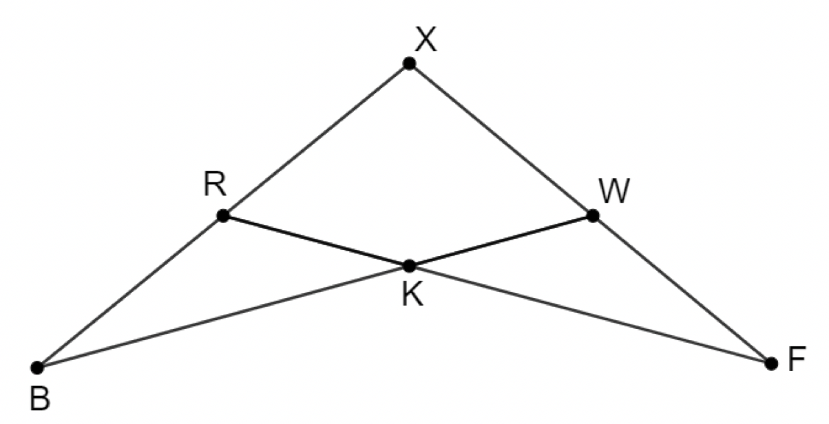

5.7.2 Collaboration: Overlapping Triangles
volume 1, pg. 263

Slide 9
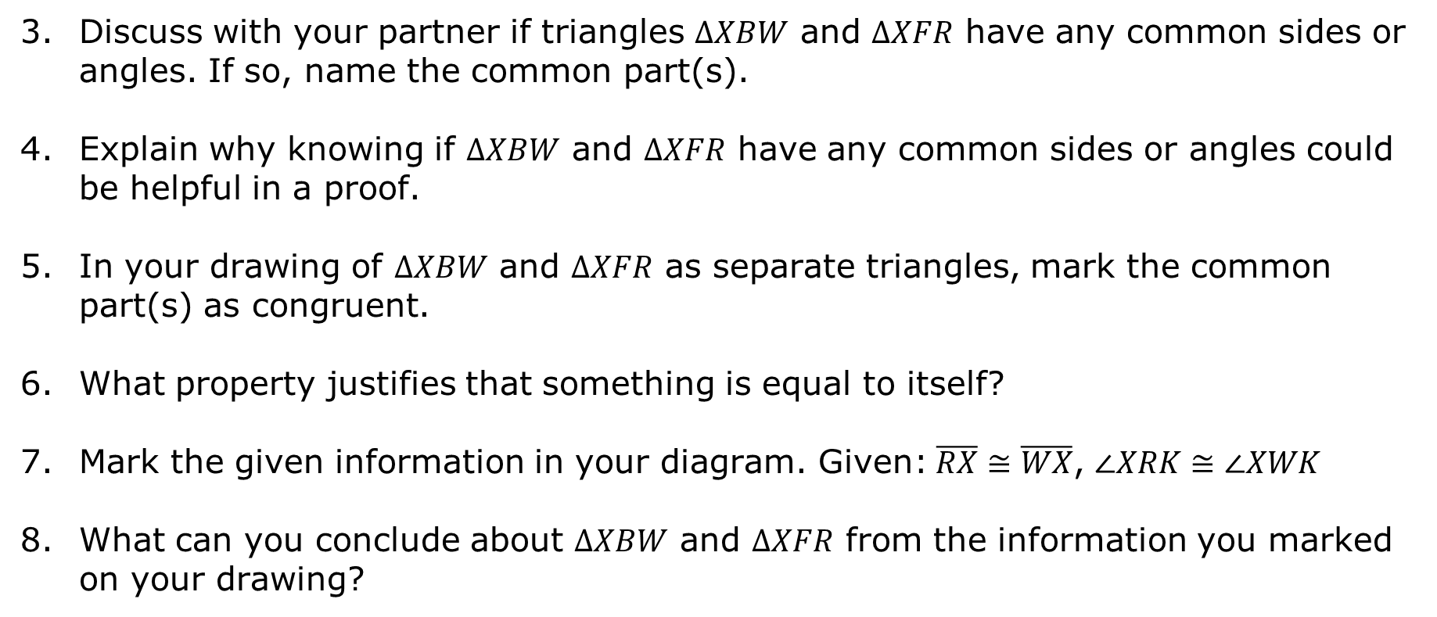
volume 1, pg. 263

Slide 10
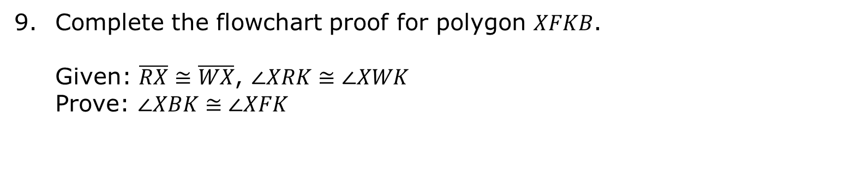
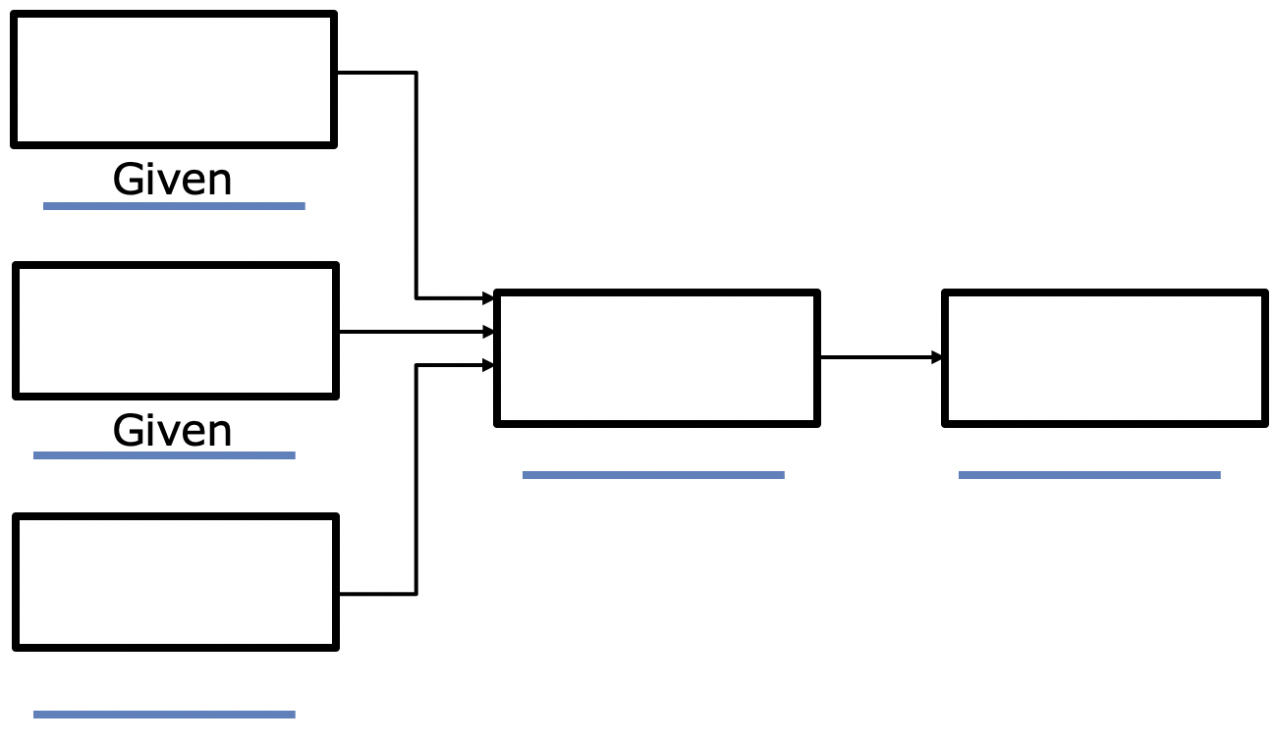
Check your proof with another group and if necessary, make adjustments.
volume 1, pg. 264

Slide 11

Guided Instruction
volume 1, pg. 264

Slide 12

5.7.3 Guided Instruction: Proofs Using CPCTC
Once two triangles have been proven to be congruent, then CPCTC states that any other corresponding parts of the triangles are also congruent.
Corresponding Parts of Congruent Triangles are Congruent (CPCTC)
If two triangles are congruent, then all corresponding parts of the triangles are congruent.
volume 1, pg. 264

Slide 13
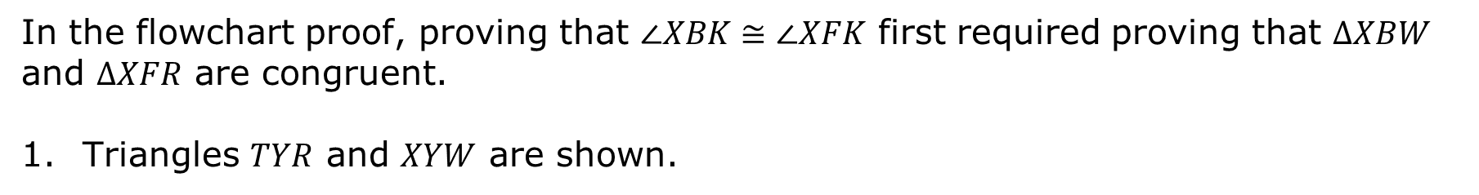
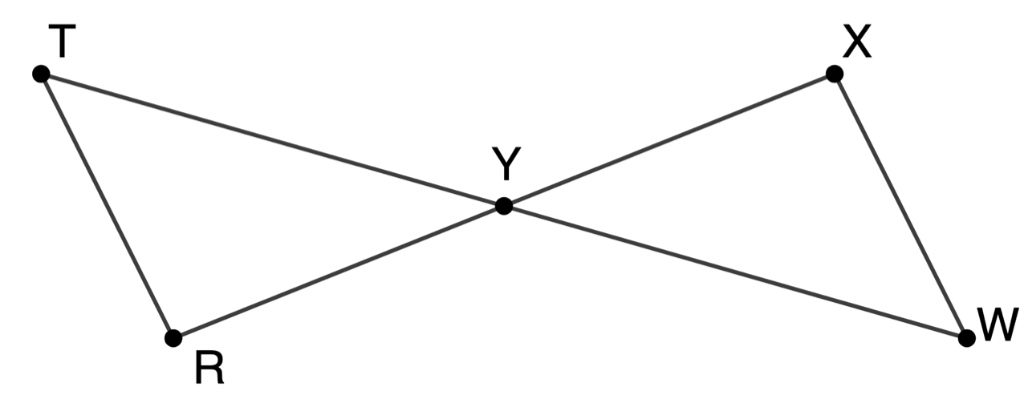
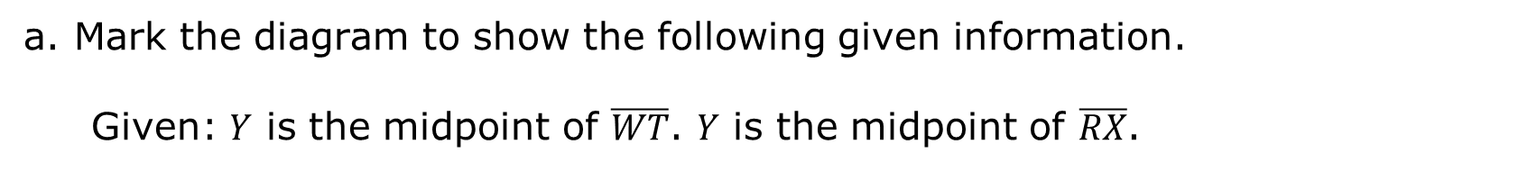
volume 1, pg. 264

Slide 14
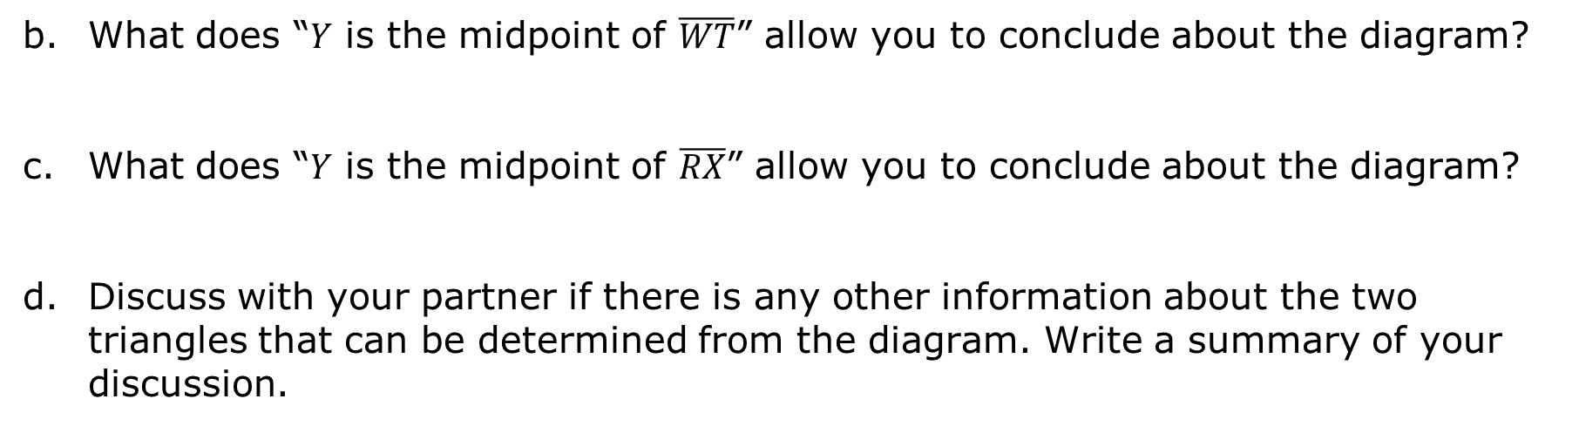
volume 1, pg. 265

Slide 15
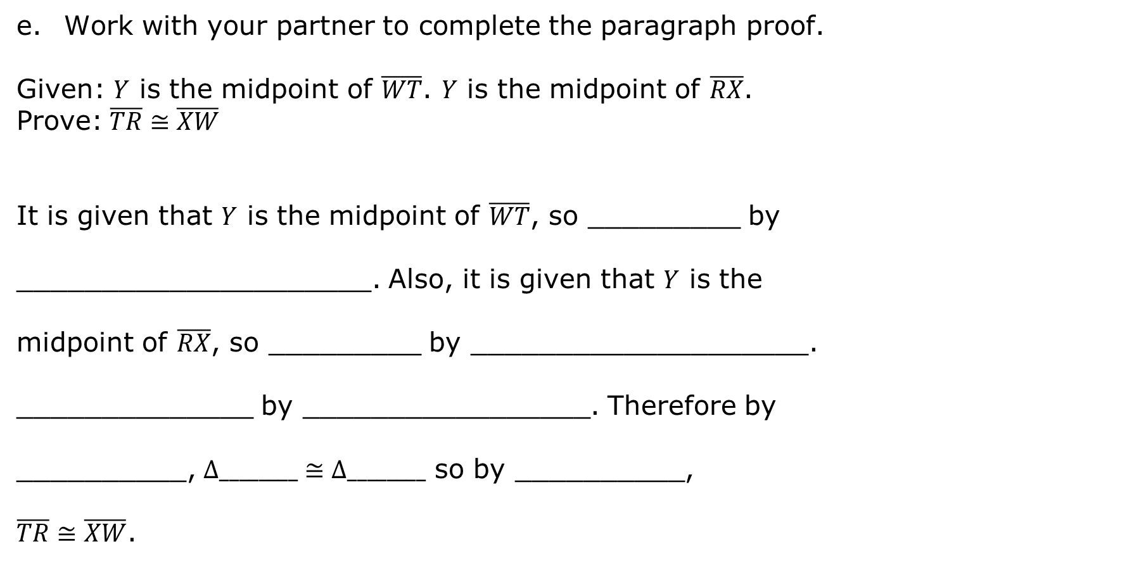
volume 1, pg. 265

Slide 16
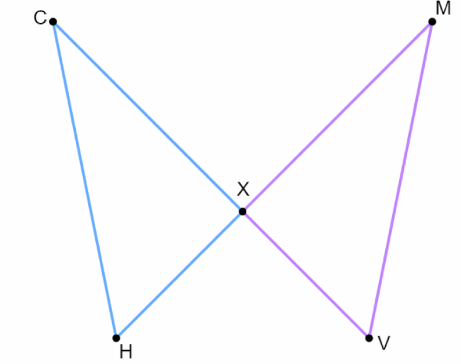

Mark the diagram to show the given information.
b. Which congruence theorem or postulate do you think should be used?
volume 1, pg. 265

Slide 17
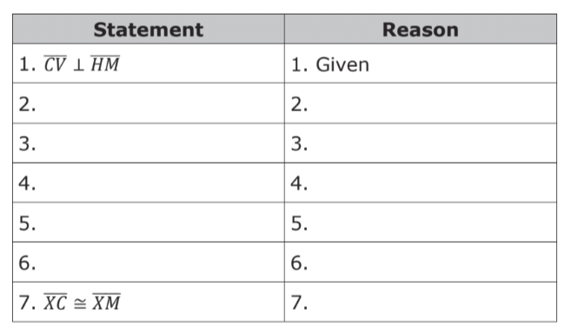
Complete the two-column proof.
volume 1, pg. 265

Slide 18

Guided Practice
volume 1, pg. 266

Slide 19

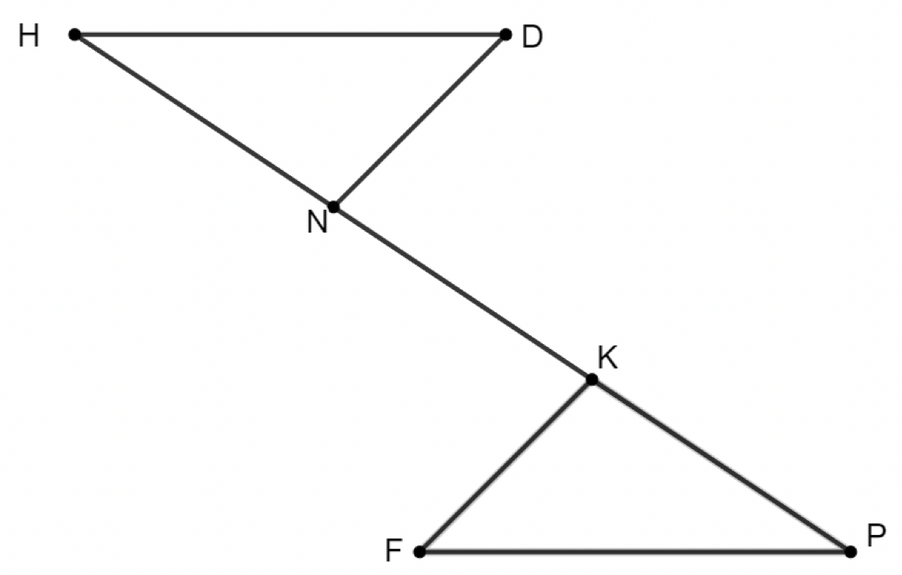
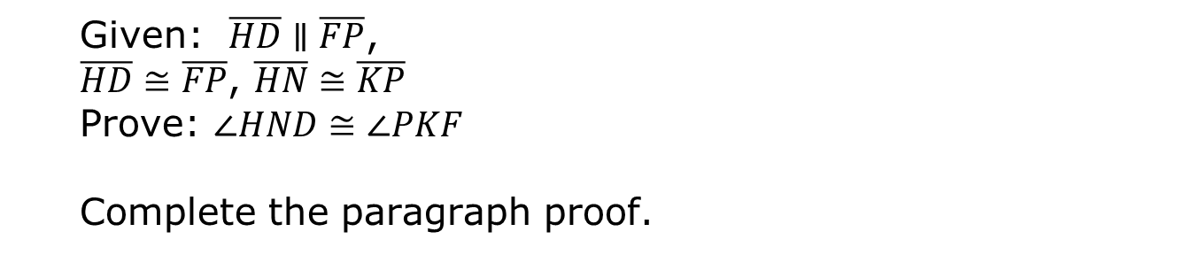
5.7.4 Guided Practice: Proofs Using CPCTC
volume 1, pg. 266

Slide 20
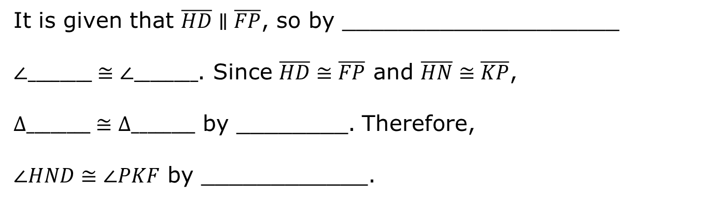
volume 1, pg. 266

Slide 21

Your Turn
volume 1, pg. 266

Slide 22
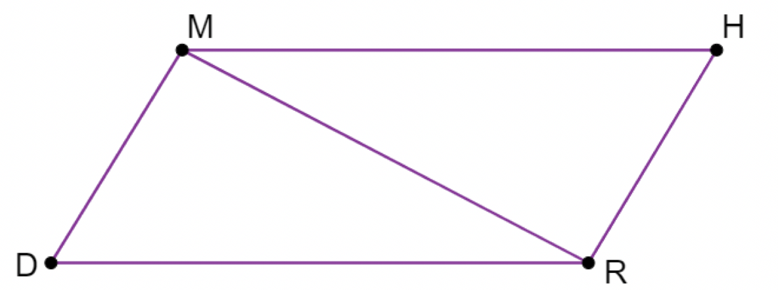
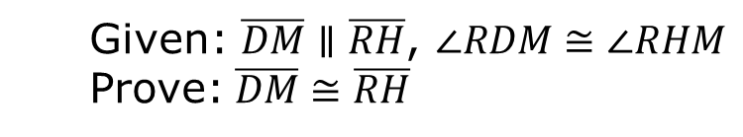
5.7.5 Your Turn!
volume 1, pg. 266

Slide 23
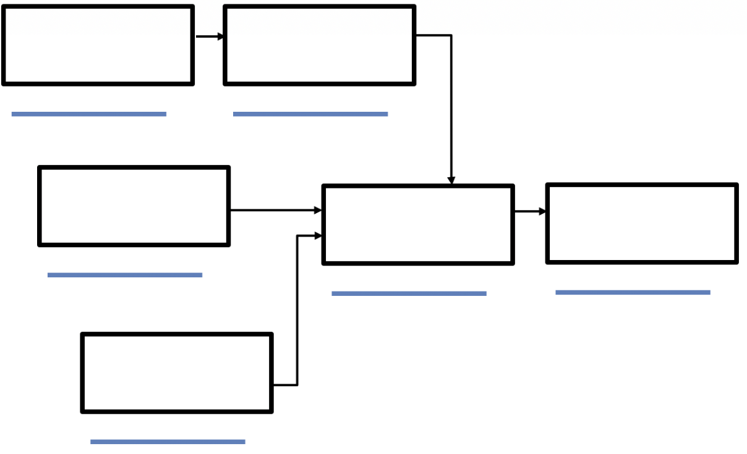
Complete the flowchart proof.
volume 1, pg. 266

Slide 24

Wrap-Up
volume 1, pg. 267

Slide 25
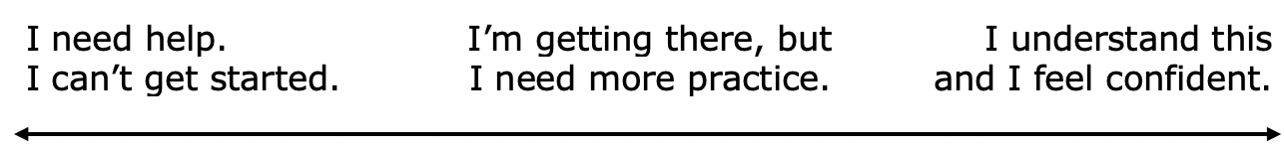
5.7.6 Wrap-Up: Reflection
Draw an X on each line to indicate where your current learning is related to each target.
I understand how to use corresponding parts of congruent triangles in a proof.
2. I can prove parts of triangles are congruent using triangle congruence and corresponding parts of congruent triangles.
volume 1, pg. 267

